Slide 1
E-Commerce Sales Analysis for Data-Driven Decision Making & Customer Insights Report
A Data-Driven Business Analysis
Name: Swaraj Verma
Date: 5/6/2025

Slide 2
Objective:
To analyze sales performance, understand customer behavior, and forecast future trends to support data-driven decision-making.
Scope:
Sales trends
Customer insights
Forecasting
Business opportunities & recommendations

Slide 3
Monthly & Yearly Sales Trends
Visuals:
Line chart showing monthly sales trend over the past 12–24 months.
Bar chart comparing yearly revenue growth (e.g., 2022 vs. 2023 vs. 2024).
Insights (example placeholders):
Peak sales occurred in November and December, indicating strong holiday demand.
YoY growth of 15% in 2024, driven by new product launches.

Slide 4
Geographic Sales Distribution
Visuals:
Map chart (if regional data available) showing sales density by state/region.
Stacked bar chart by region showing total sales & product category split.
Insights:
Metro areas (e.g., Mumbai, Bangalore) contribute over 60% of sales.
Emerging growth observed in Tier 2 cities, especially in the East region.

Slide 5
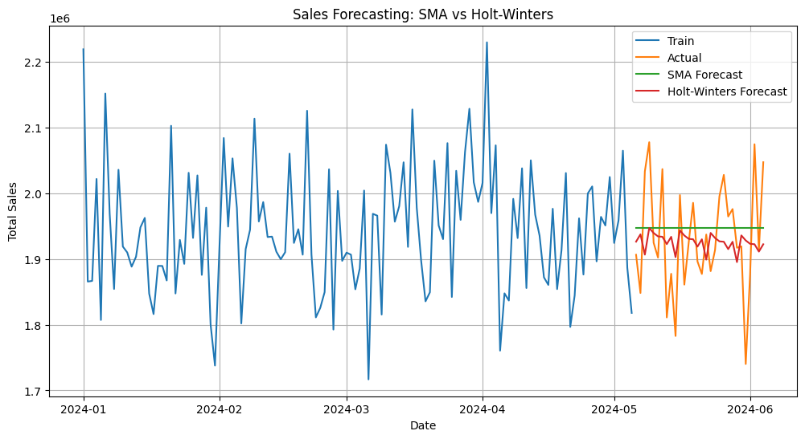

Slide 6
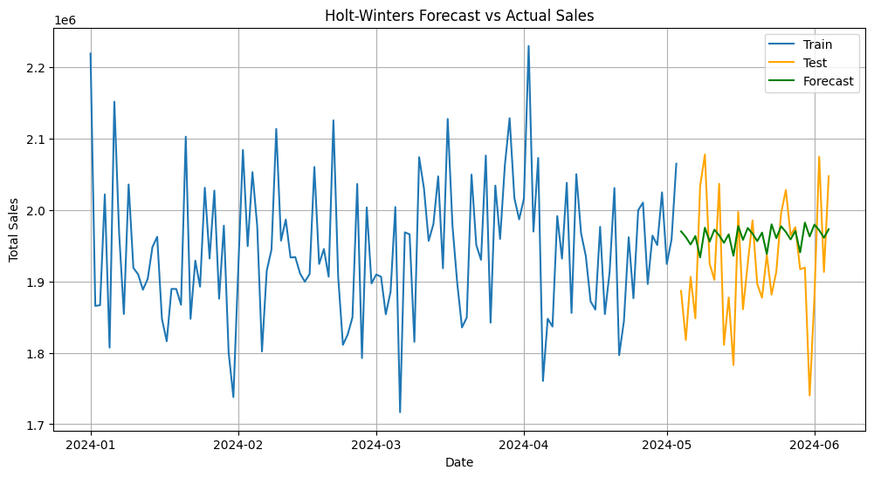

Slide 7
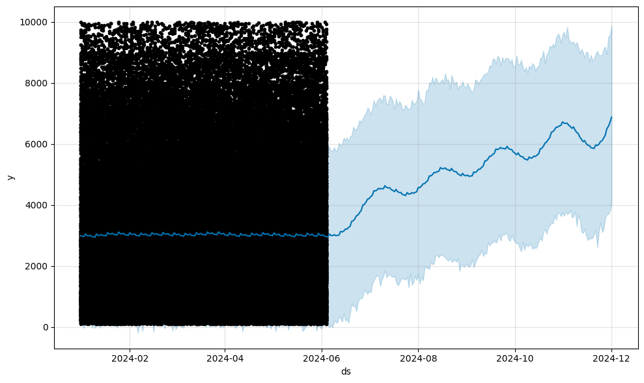

Slide 8
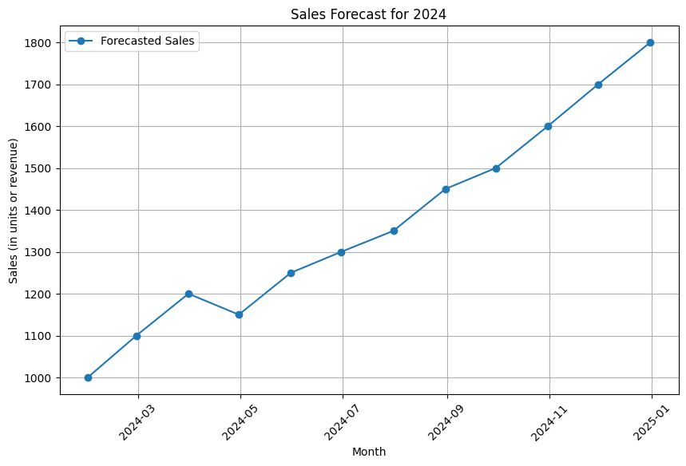
Sales forecast for 2024

Slide 9
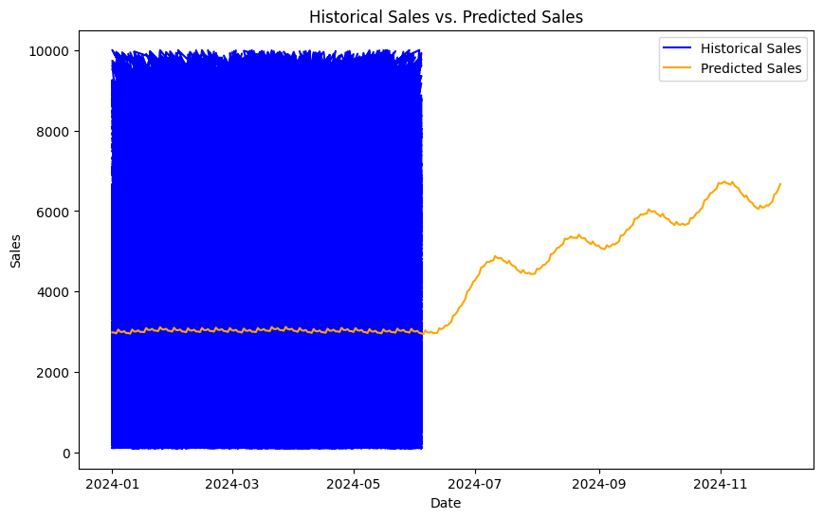
Historical Sales VS Predicted Sales

Slide 10
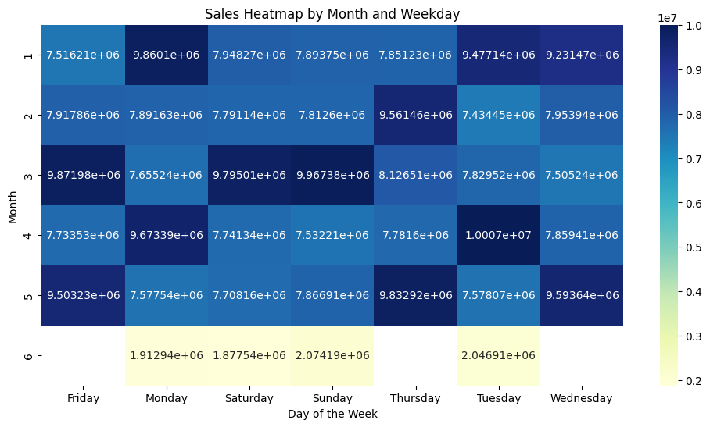
Sales Heatmap by month and Weekday

Slide 11
Sales Forecasting Based on past sales patterns and seasonal cycles, our model forecasts a 12–15% increase in overall sales next quarter, driven by planned campaigns and new product launches. This helps us prepare inventory and resources in advance.”

Slide 12
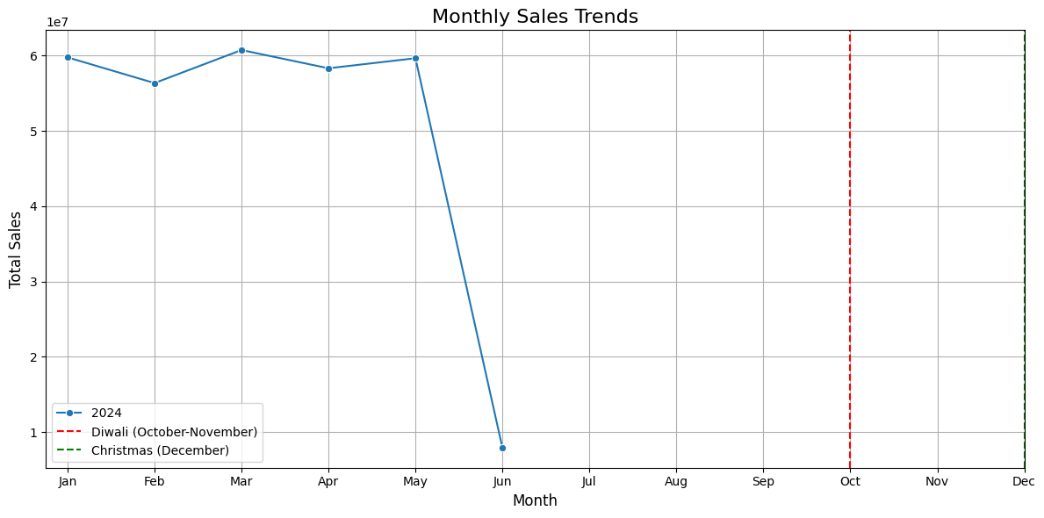
Monthly sales trends

Slide 13
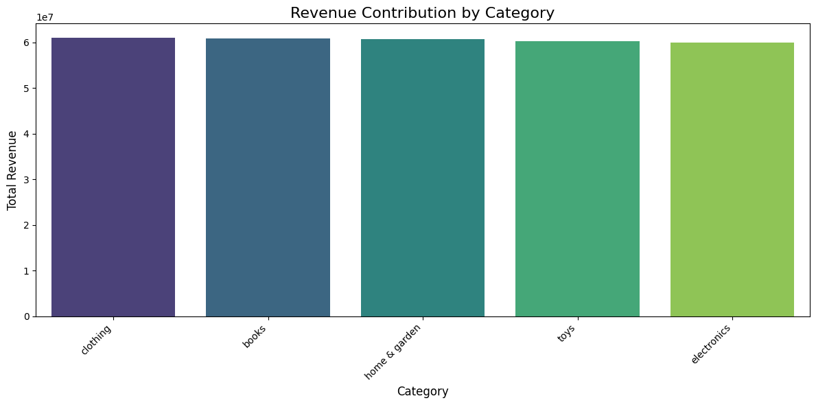

Slide 14
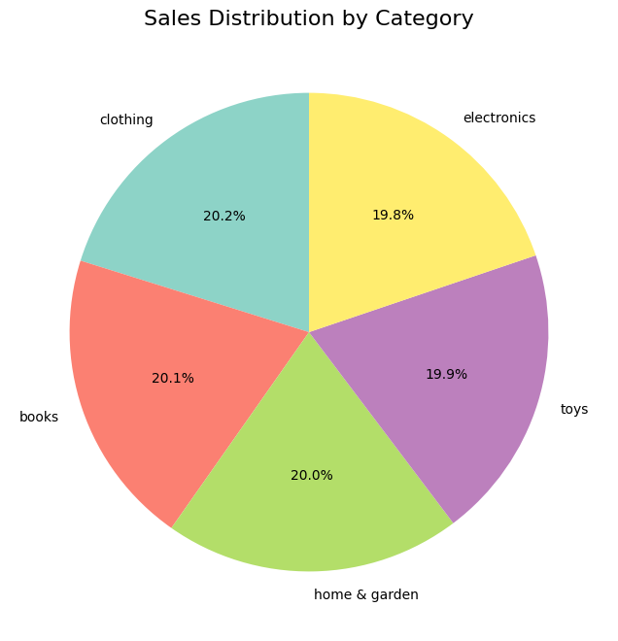

Slide 15
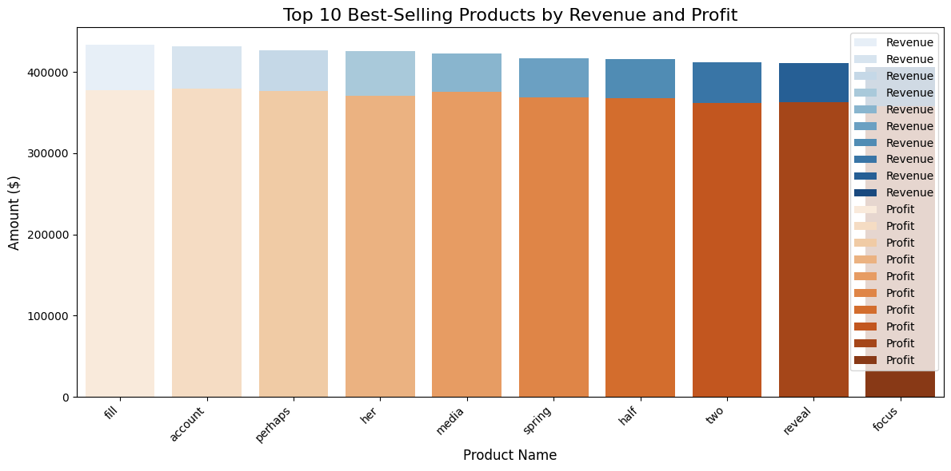

Slide 16
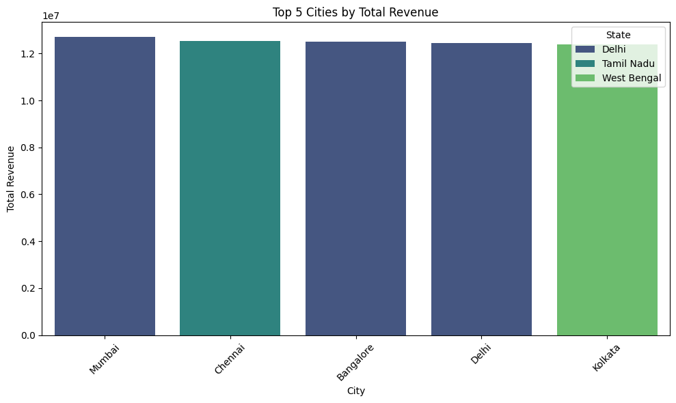

Slide 17
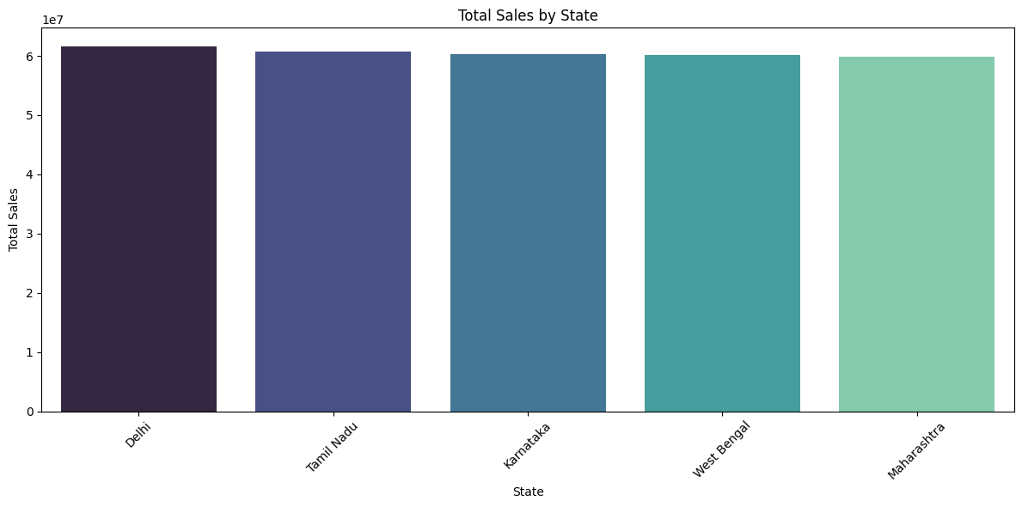

Slide 18
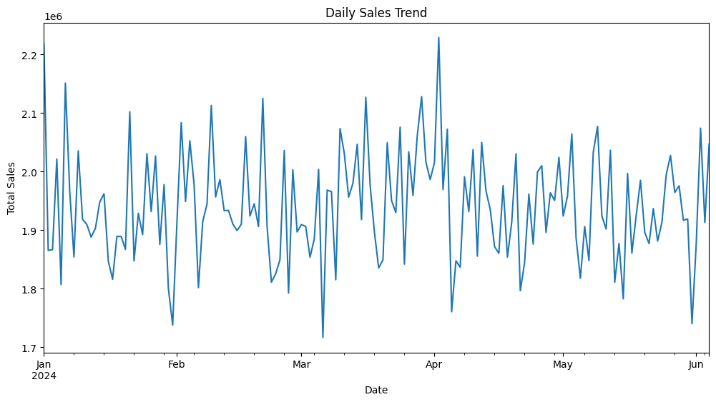

Slide 19
Conclusion or summary . Corporate financial performance was analyzed using data extracted from 10-K reports of major publicly listed companies. . Key financial indicators such as revenue trends, profit margins, debt ratios, and cash flows were examined. . The analysis revealed drivers of revenue growth, cost inefficiencies, and potential financial risks (e.g., rising debt-to-equity ratios). . The chatbot allows users to interactively query financial data, improving due diligence and strategic planning. . Overall, this enhances decision-making, reduces manual workload, and empowers data-driven advisory outcomes.

